Slide 1

Automatic License Plate Recognition System
Computer Vision Case Study using OpenCV & Python
Presented by: Mishra Anshika | Bsc Data Science 3rd year [BSC23DS86]
Under the guidance of : Dr. Shivani Choudhary

Slide 2
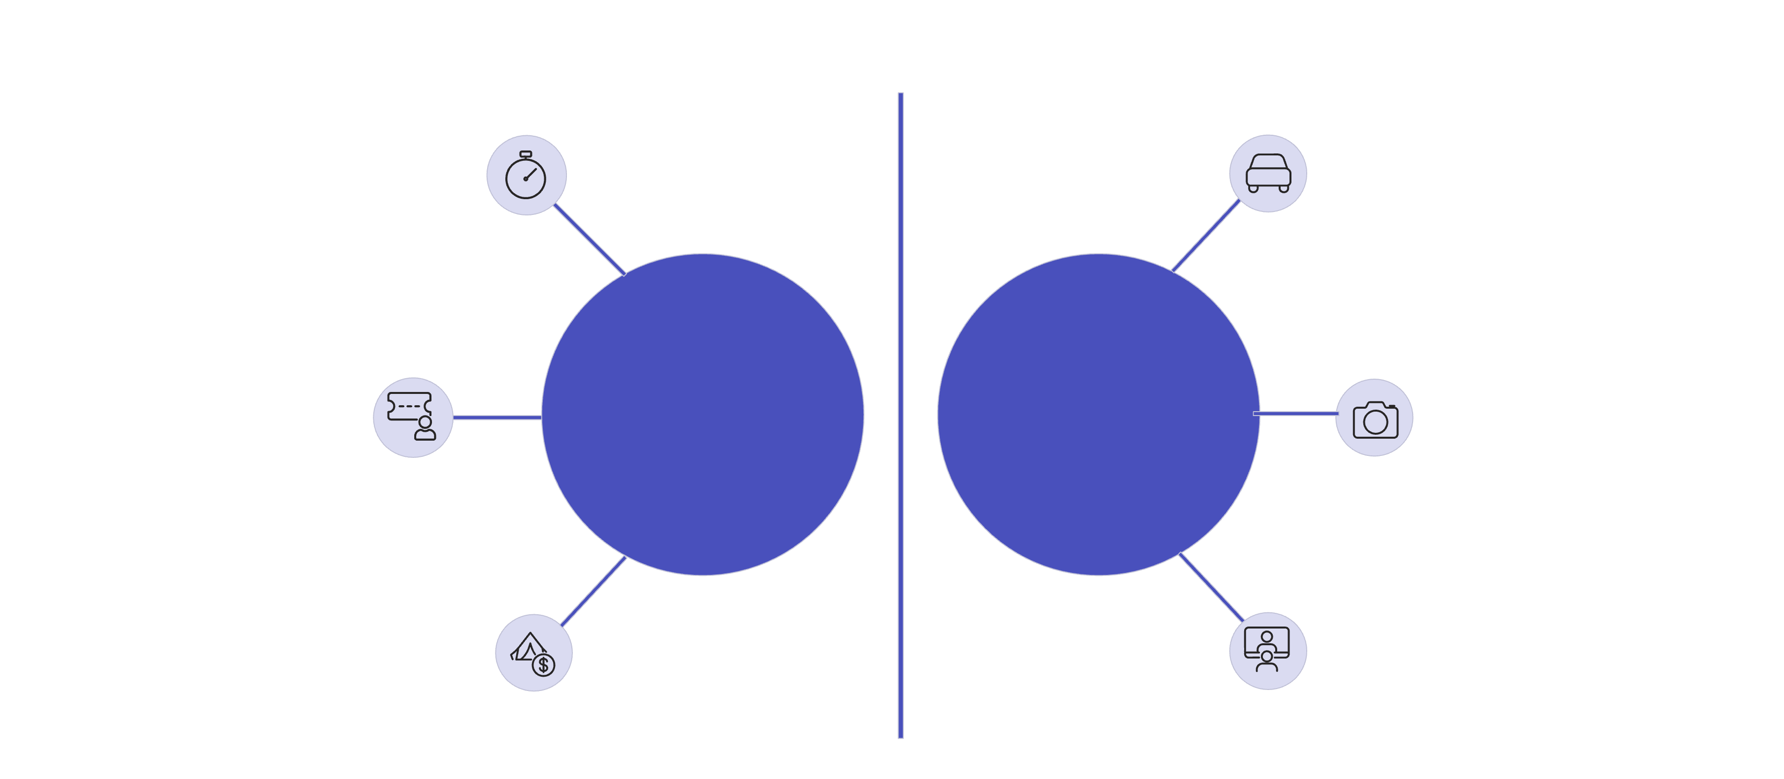


Why ANPR? The Real-World Problem
The Challenge: Manual Systems
Our Solution: Automatic Vision
Checking license plates by hand is notoriously slow, expensive, and highly prone to human error. This is inefficient for large-scale operations like busy car parks or traffic surveillance.
An Automatic Number Plate Recognition (ANPR) system uses computer vision to autonomously detect and read plates from vehicle images.
Slow processing times.
Sub-second Speed
Processes vehicles in under 1 second.
Requires constant human staffing.
High chance of incorrect data entry.
24/7 Monitoring
Operates continuously without human fatigue.
Stop Car
Stop Car
Staff Checks Plate
Manual Process
Automated ANPR
Camera Captures Image
Gate Opens (Slow, Error-Prone)
System Reads Plate
Gate Opens (Slow, Error-Prone)
System Reads Plate

Slide 3
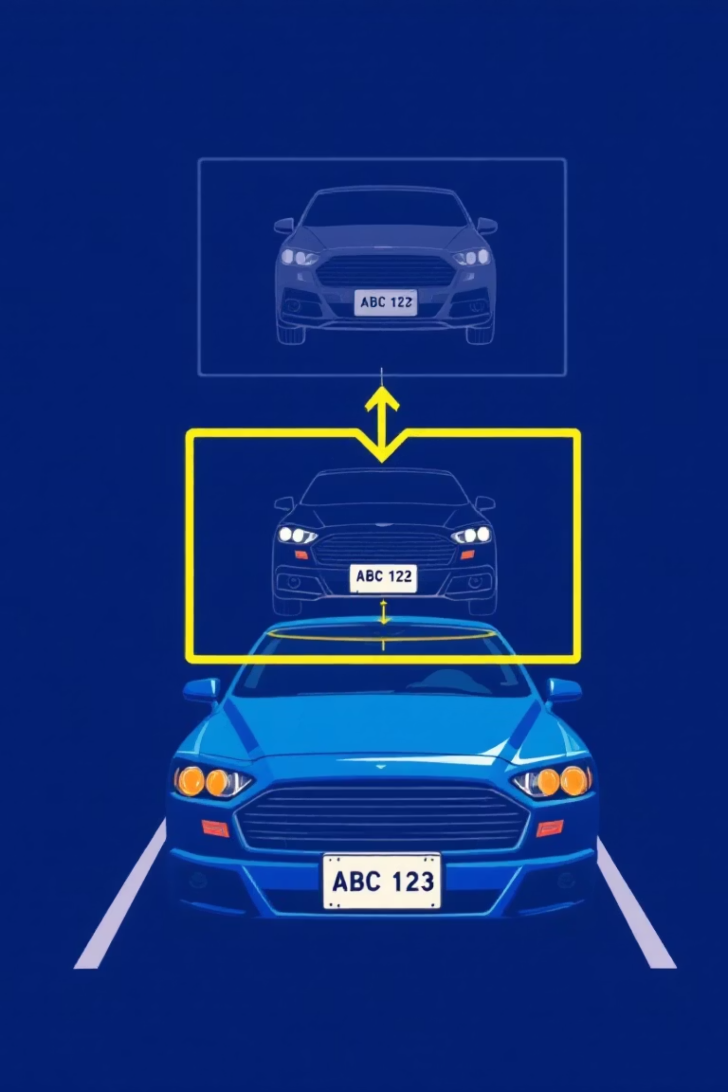




ANPR System - Step by Step
1. Load Image
The camera captures the car image, and it is loaded into the Python environment for processing.
2. Find Plate
Computer Vision algorithms detect the rectangular area of the license plate within the full image.
3. Clean Image
Image enhancement techniques (like filtering) are applied to remove noise and improve clarity.
4. Read Text
Optical Character Recognition (OCR) extracts the actual letters and numbers from the cleaned plate image.

Slide 4
Core Code - The Detection Stage
We use the OpenCV library (cv2) for image manipulation and noise reduction, preparing the image for detection.
Step 1 - Load and Pre-Process
Step 2 - Find the License Plate Area
import cv2import easyocr# Load car imageimg = cv2.imread('car.jpg')# Convert to grayscalegray = cv2.cvtColor(img, cv2.COLOR_BGR2GRAY)# Remove noise (make image cleaner)clean_img = cv2.bilateralFilter(gray, 11, 17, 17)
# Find edges in imageedges = cv2.Canny(clean_img, 30, 200)# Find all shapes (contours) in imagecontours, _ = cv2.findContours(edges, cv2.RETR_TREE, cv2.CHAIN_APPROX_SIMPLE)# Look for rectangle shapes (license plates are rectangular)for shape in contours: x, y, w, h = cv2.boundingRect(shape) if w > h and w > 80: # Filter by aspect ratio (wider than tall) plate = img[y:y+h, x:x+w] # Cut out the plate

Slide 5
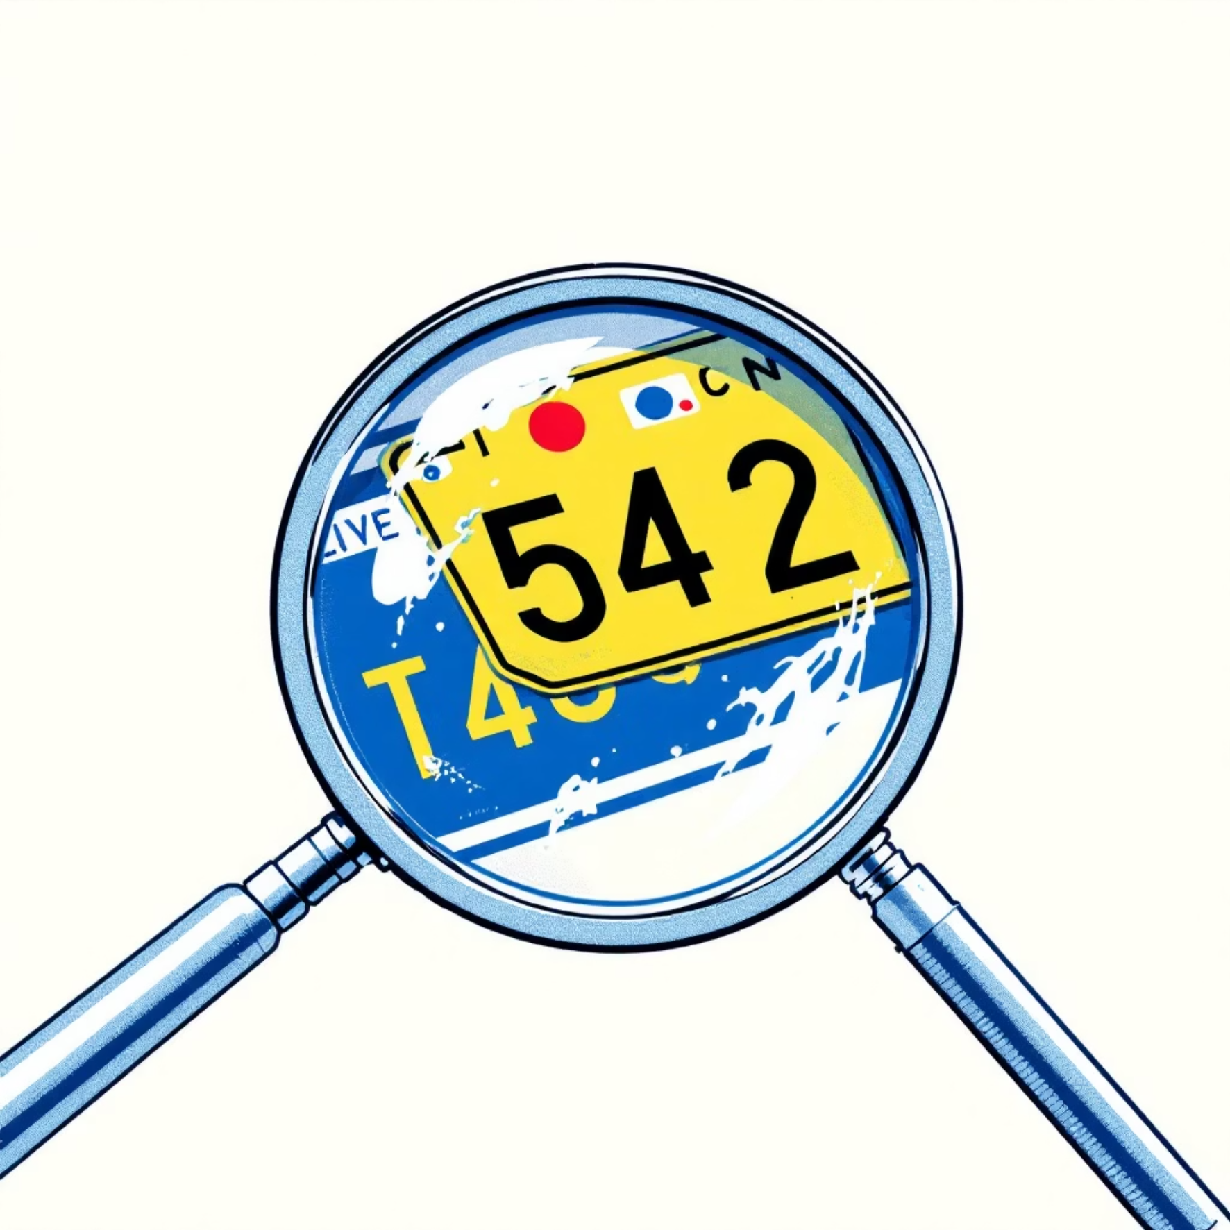
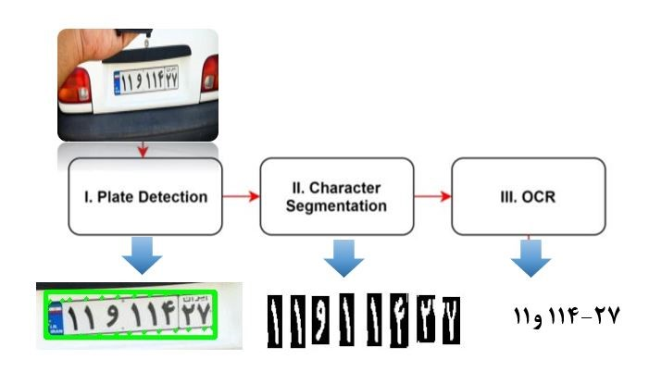
Text Recognition - The Final Step
Once the plate area is isolated, we employ the EasyOCR library to convert the pixels into digital text.
Simple OCR Code Snippet
Putting It Into a Function
For usability, we wrap all processing into a single, reusable function that takes the image path and returns the license plate number.
# Initialize text reader
reader = easyocr.Reader(['en'])
# Read text from license plateresult = reader.readtext(plate)if result:
# result[0][1] holds the recognized text plate_text = result[0][1] print(f"License Plate: {plate_text}")else: print("No text found")
def detect_license_plate(image_path):
# ... processing steps ...
return plate_text

Slide 6

Our Results - Does It Work?
Testing across various images demonstrates high accuracy, with performance strongly tied to the initial quality of the vehicle photo.
Detection Success
High Accuracy
Fast Processing
Successfully identifies the license plate boundary even on complex backgrounds.
Recognized text matches the actual plate number in over 90% of clear images.
Processing time remained consistently under 1 second across all tested images.
⚠️ Key Takeaway: Image quality is crucial. The system struggles with photos that are extremely blurry, taken in very low light, or heavily obstructed.

Slide 7



Project Success & Learning Outcomes
✅ Technical Skills Gained
🚀 Real-World Applications
Mastered image processing concepts with OpenCV.
Applied Python for a complex, real-world application.
Shopping Mall Parking
Gained hands-on experience with edge detection and image enhancement.
Automated entry and exit for seamless customer
experience.
Understood the fundamentals of computer vision pipelines.
University Campus Tracking
📚 Course Topics Covered
Monitoring authorised vehicles for campus security and management.
Digital Image Processing, Edge Detection, Image Enhancement, Python Libraries (OpenCV, EasyOCR).
Apartment Access Control
Securing residential gates by validating registered
plates.
Final Achievement: Built a working system from scratch!

